Slide 1
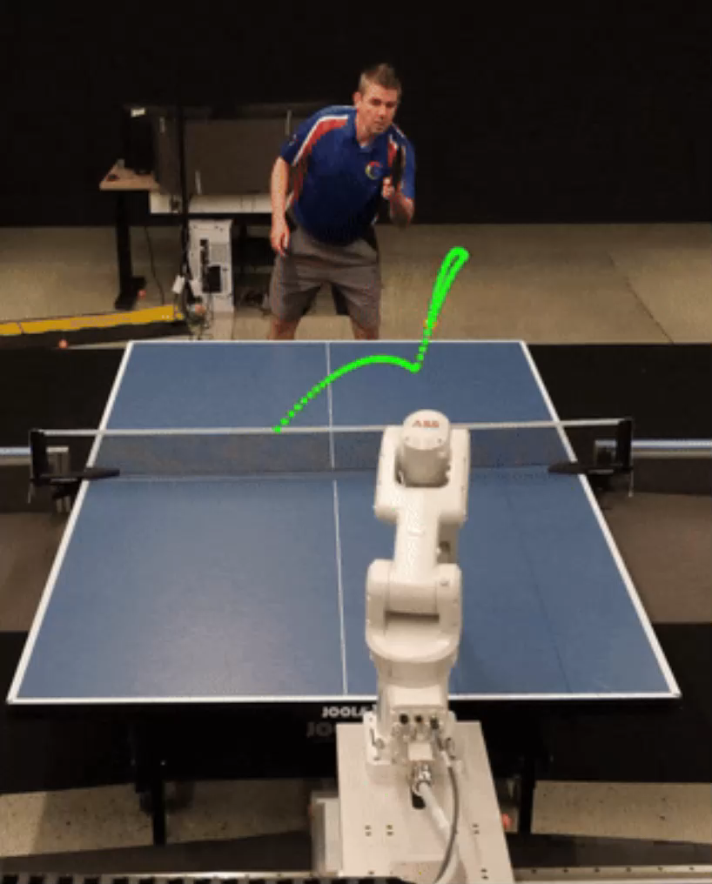

Achieving Human Level Competitive Robot Table Tennis
Arxiv – Aug 2024

Slide 2
Motivation
Challenges human-level accuracy, speed, and adaptability
Requires complex skills and strategy, unlike purely strategic games
Demonstrates:
High-speed motion
Real-time precision
Strategic decision-making
Advanced system design
Enables direct human-robot competition

Slide 3
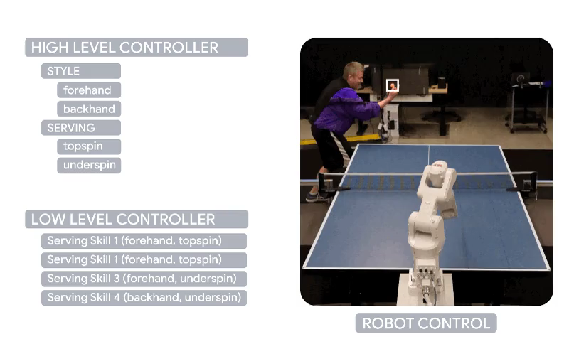
Overview
Competitive play at human level and a robot agent that humans enjoy playing with

Slide 4
Contributions
A hierarchical and modular policy architecture
Techniques to enable zero-shot sim-to-real including an iterative approach to defining the training task distribution that is grounded in the real-world
Real time adaptation to unseen opponents
A user-study to test our model playing actual matches against unseen humans in physical environments

Slide 5
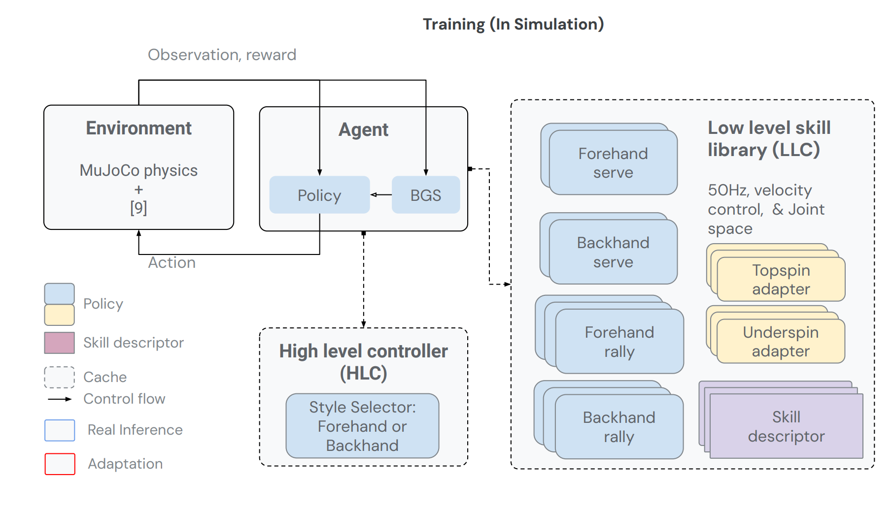
Methodology

Slide 6
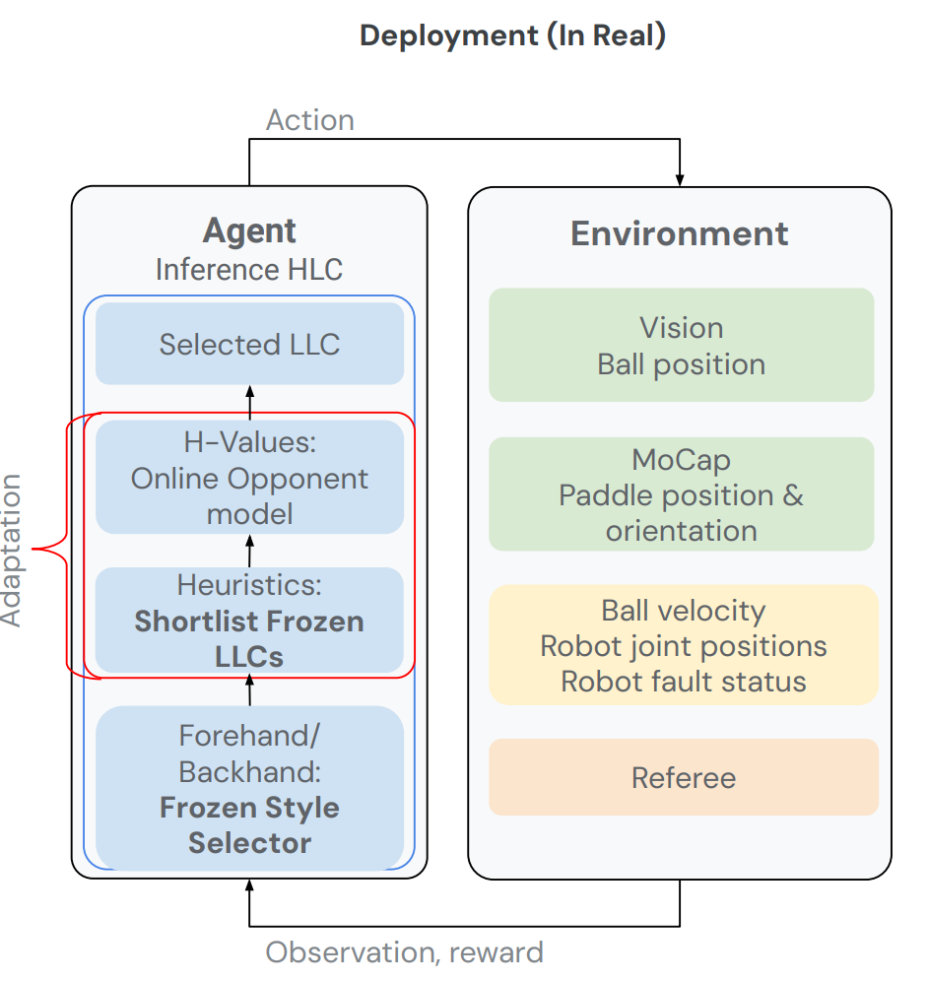
Methodology

Slide 7
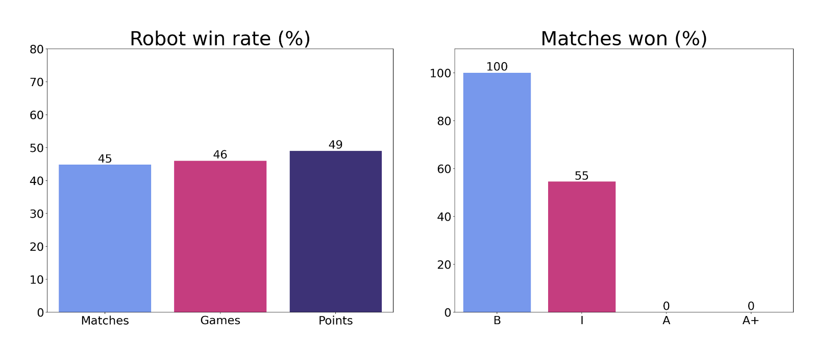
Results
Total matches : 29
Skill levels: beginner, intermediate, advanced, and advanced+

Slide 8
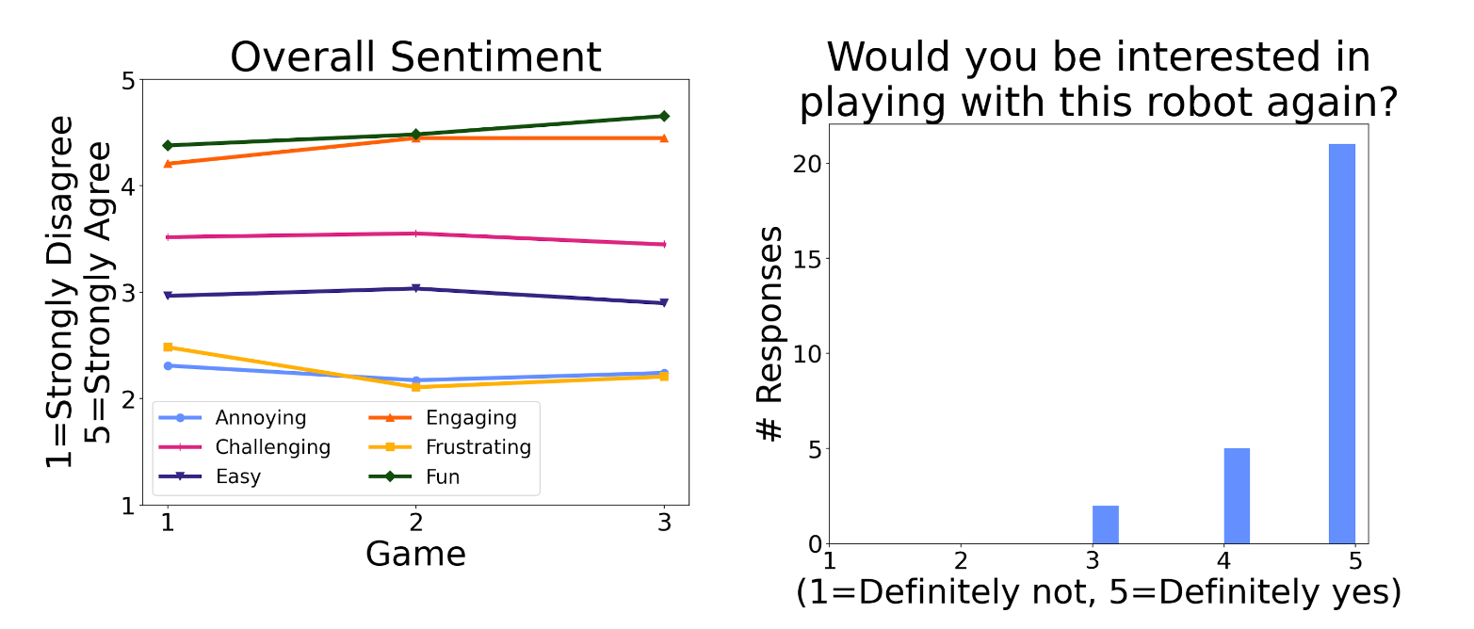
Human Perception

Slide 9
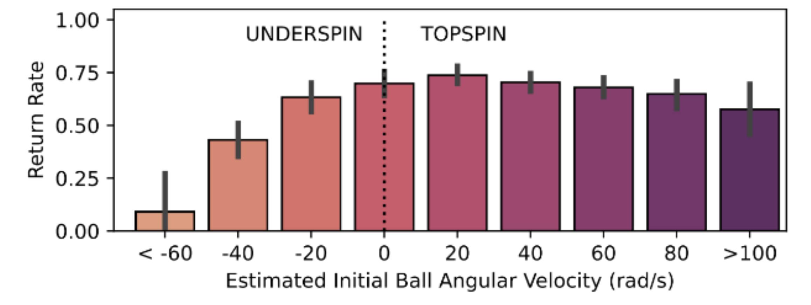
Limitations
Weak in handling underspin due to difficulty of:
Handling low balls to avoid collision with the table
Determining ball spin in real time

Slide 10
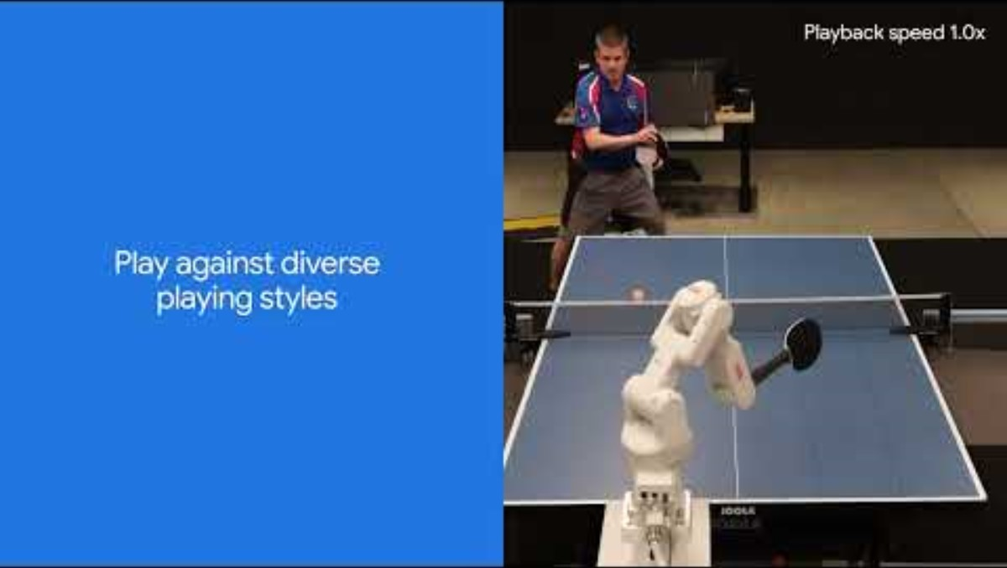
Demonstrations

Slide 11
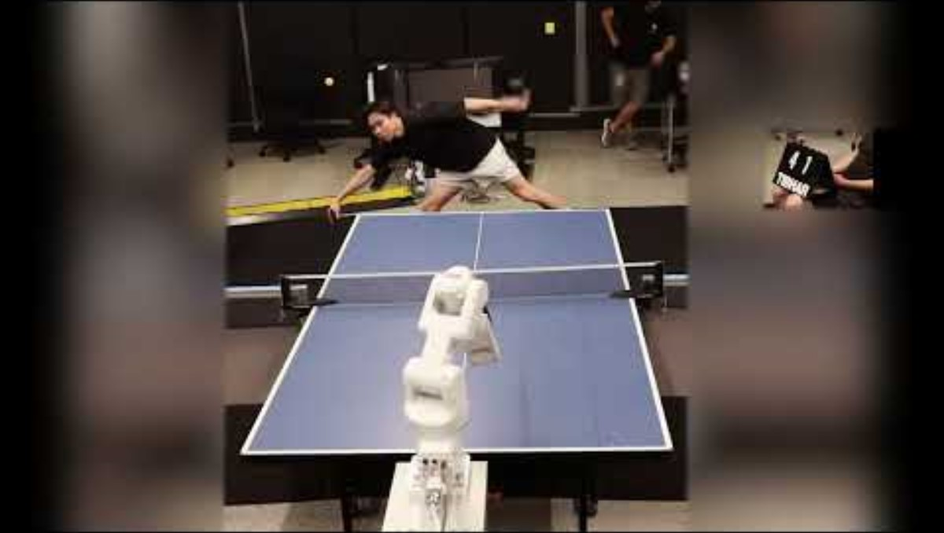
Highlights

Slide 12
Thank you!

